Slide 1

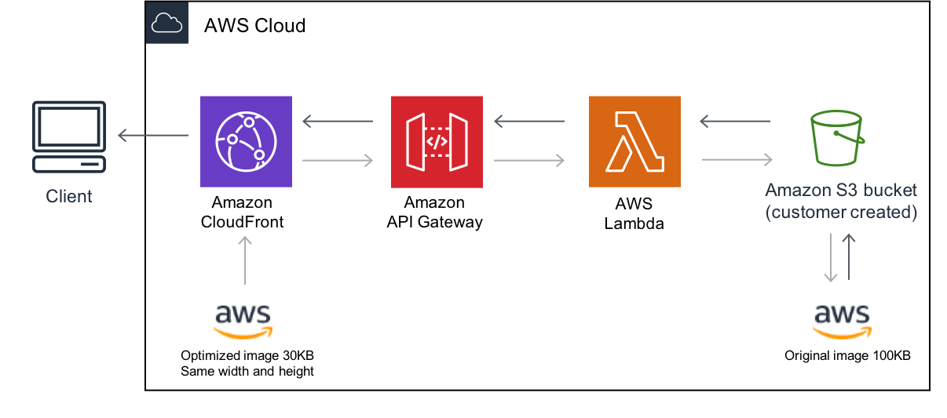
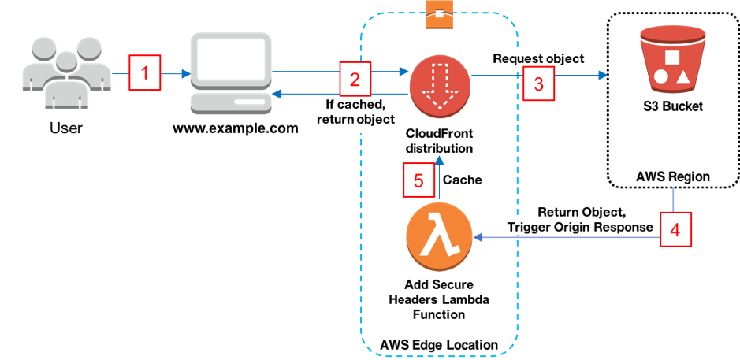

Amazon Web
Service
Serverless Image Processing
&
Deploy a Static Website on AWS
MJ
By Manu Jaiswal

Slide 2
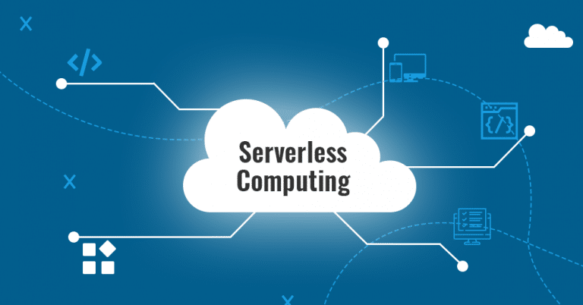
Serverless Image Processing :

Slide 3


Introduction :
In today's digital landscape, where visuals hold unparalleled significance, the demand for efficient and scalable image processing is paramount. Imagine an architecture that seamlessly transforms and optimizes images on-the-fly, without the burden of managing complex server setups. This is where the power of serverless computing comes into play.
The internet has become an integral part of our lives, and having a strong online presence is essential for businesses, organizations, and even personal brands. A static website, often the foundation of these online identities, offers a clean, efficient, and user-friendly way to showcase content, services, or information.

Slide 4
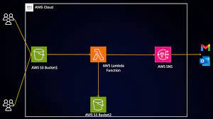

02 Serverless Image Processing Workflow :
03 Amazon S3 for
Storage :
Explain the role of Amazon S3 as a highly scalable object storage service .
Highlight its durability, availability, and ease of use.
Emphasis its integration with Lambda.
Image upload to S3 bucket trigger Lambda function.
Lambda processes the image and publishes a notification to SNS.
SNS sends notification to subscribers.
Amazon S3

Slide 5

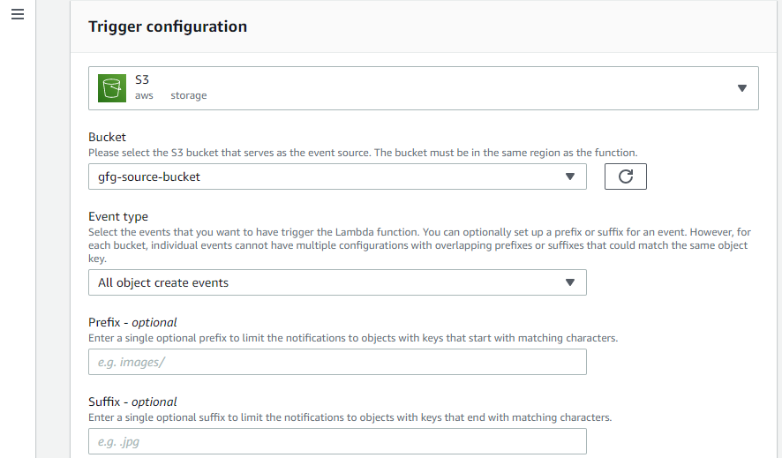
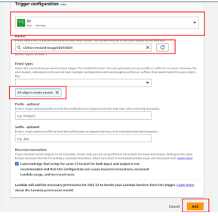
04 Simple Notification Service :
05 Lambda Function Configuration :
Explain how SNS facilitates communication and notifications.
Mention its use in sending processing notifications.
Describe Amazon SNS as a pub/sub messaging service.
Configure S3 trigger to invoke the Lambda function on image upload.
Choose runtime and set up a role with appropriate permissions.
Provide steps to create a Lambda function:
SNS

Slide 6
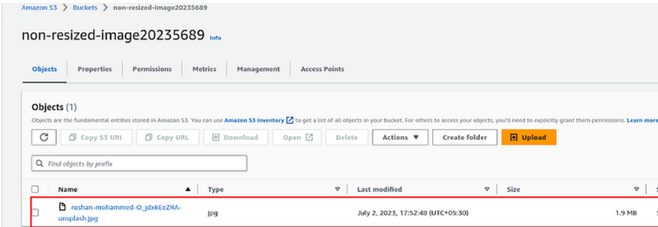
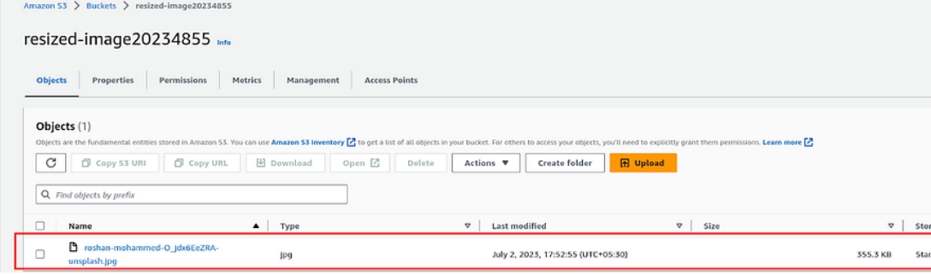
Demo and Testing :
Just upload the image in First Bucket and see the Magic :
The Image is of 1.9MB in the Bucket 1.
- The Image has been resized automatically from 1.9MB to 355.3KB

Slide 7

Deploy a Static Website on AWS :

Slide 8
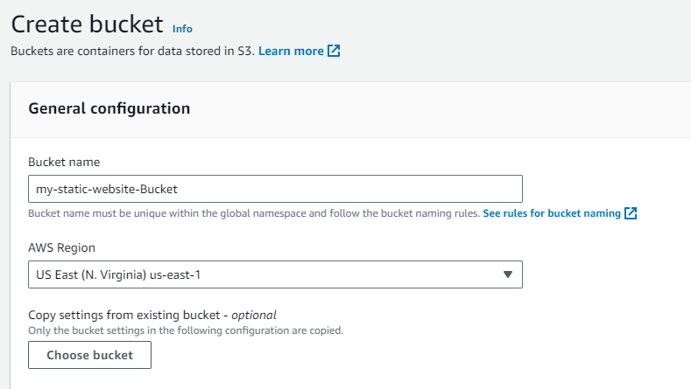
Creating a S3 Bucket :
Go to the Amazon S3 service in the AWS Management Console.
Click "Create Bucket" and give your bucket a unique name (e.g., "my-static-website-bucket").
Choose a region for your bucket (preferably the one closest to your target audience).

Slide 9
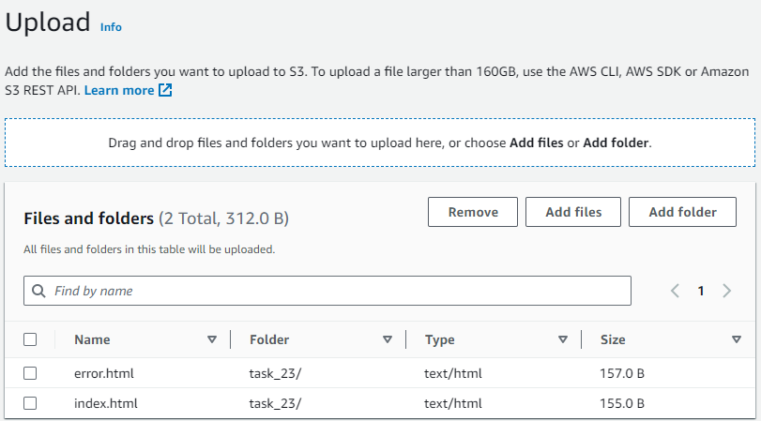
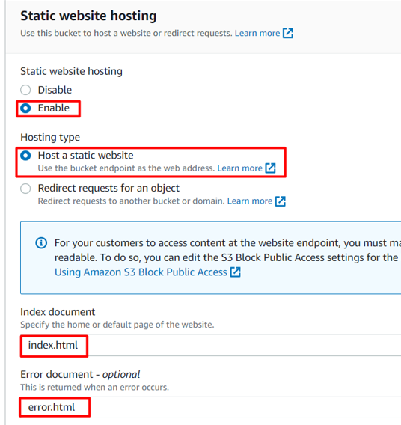
Upload Website Files : Open your newly created bucket and click "Upload." Select your website files and upload them to the bucket.
Configure Bucket for Static Website Hosting:
In your bucket's properties, navigate to the "Static website hosting" section.
Choose "Use this bucket to host a website."
Enter the name of your main HTML file (e.g., "index.html").
Save the configuration.

Slide 10
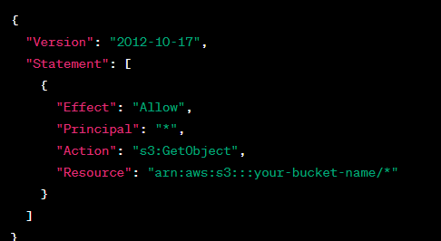
Set Permissions:
Before creating the policy, you will need to copy the ARN (Amazon Resource Name) of your bucket.
Copy the ARN of your bucket to the clipboard. It is displayed at the top of the policy editor. it will look like ARN:“arn:aws:s3:::your-bucket-name".
In the policy below, Update the bucket ARN on the Resource key value and paste the below policy code in the editor.

Slide 11


Test the website and the error page :
After saving the bucket policy, you'll receive an "Endpoint" URL. This is your website's URL. It may take a few minutes for changes to propagate.
Test your website by accessing the Endpoint URL in a web browser.
Copy the static website URL (which we saved earlier) , but this time, add some random characters to the end of the url to break it. When satisfied, hit [Enter]. You will be redirected to the error.html page automatically.

Slide 12
Conclusion :
In conclusion, serverless image processing in AWS offers an efficient, cost-effective, and scalable solution for handling various image-related tasks. By leveraging AWS Lambda and other services, you can build automated, secure, and flexible workflows that meet the dynamic demands of modern applications while minimizing operational overhead.
In conclusion, deploying a static website on AWS offers a seamless and powerful solution for hosting your online content. By harnessing the capabilities of Amazon S3 for storage, Amazon CloudFront for content distribution, and other AWS services for domain management and security, you can ensure a fast, reliable, and secure browsing experience for your users.

Slide 13


THANK YOU

